Slide 1
PHISHING
AWARENESS

Slide 2


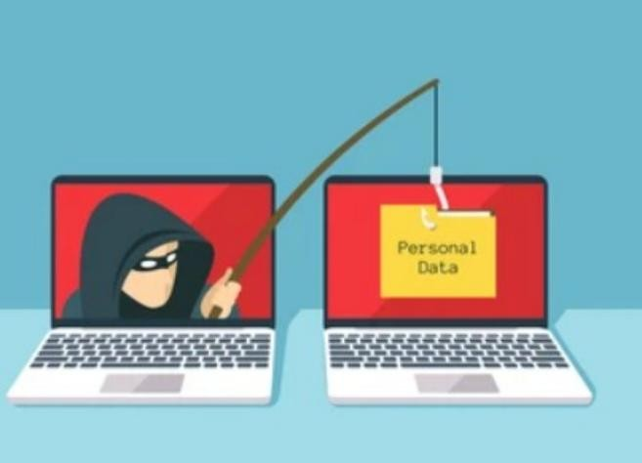



IN T R O D U C T I O N TO PHISHING
Phishing is a cyberattack in which attackers pose as legitimate entities to trick users into providing sensitive information ( passwords, credit card numbers, etc.).
Examples: Fake emails, fraudulent websites, social media messages, SMS, etc.

Slide 3


01
02
03
04
EMAIL PHISHING
Fake emails pretending to be from banks, services, or colleagues.
Characteristics: Misspelled domains, urgent requests,
su s p i c i o u s l in ks.
CLONE PHISHING
Attacker copies a legitimate email and changes a few el e m e n ts ( l ike l inks or attachments) to redirect victims to malicious sites.
SPEAR PHISHING
WHALING
Targeted attacks aimed at specific individuals or organizations.
Usually involves research to make the email appear more
convincing.
Phishing targeted at high- level executives to access sensitive
information.

Slide 4
05
SMISHING AND VISHING
Smi shi ng: Phi shi ng via SMS
Vi shi ng: Phi shi ng vi a voice calls or voicemail

Slide 5





ANATOMY OF A PHISHING EMAIL
How to Recognize a Phishing Email
Sender address:
Check if the email address is spoofed or suspicious.
Urgency or fear tactics: Warnings about account suspensions or urgent actions
3
Generic greetings: Phrases like "Dear customer" instead of your actual name.
Suspicious links or attachments
Links leading to fake websites or dangerous attachments.

Slide 6
IDENTIFYING MALICIOUS WEBSITES
How to Spot a Phishing Website
Poor design and
Requests for
URL discrepancies:
Misspelled URLs or
domains similar to legitimate ones.
Lack of HTTPS
grammar errors:
personal information:
Secure websites use HTTPS (check for the padlock symbol).
Many phishing websites
have poor grammar or formatting issues.
Legitimate companies never ask for sensitive data through websites or emails.

Slide 7
Impersonation: Attackers pretend to be someone
you trust.
Pretexting: The attacker creates a scenario to steal information
SOCIAL ENGINEERING TACTICS
Understanding Social Engineering
Baiting: Offering something (e.g., free
downloads) to lure the victim into sharing information.
Tailgating: Gaining physical access to
restricted areas by following authorized individuals.
Phishing: where attackers send emails or messages pretending to be a legitimate entity

Slide 8
WHAT TO DO IF YOU RECEIVE A PHISHING EMAIL
Steps to Take When You Suspect Phishing
Verify the sender by contacting the organization directly
Report the email to your organization's IT/security team.
Do not click any links or open attachments.
Mark the email as spam or phishing in your email client.

Slide 9
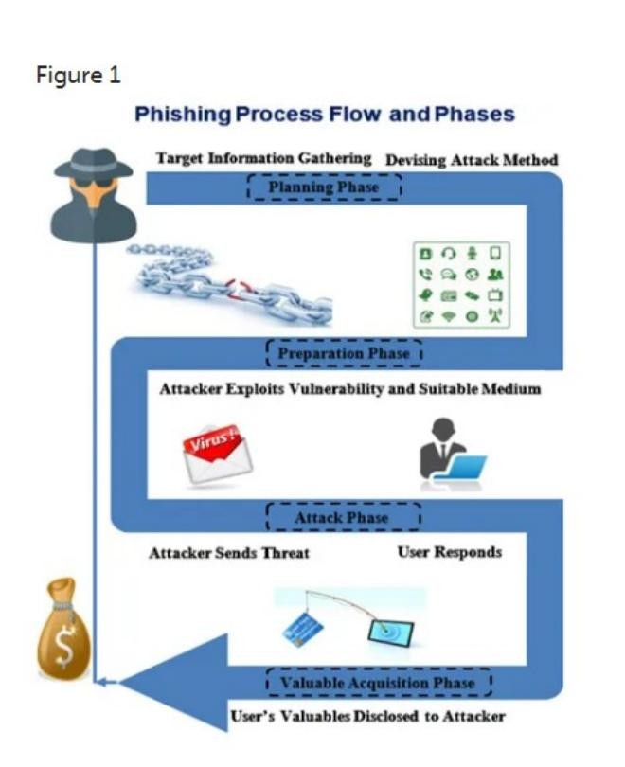
REAL-LIFE EXAMPLES
CASE STUDIES OF PHISHING ATTACKS
The 2016 DNC (Democratic National Committee) Phishing Attack:
In 2016, during the U.S. Presidential Election, the Democratic National Committee (DNC) was targeted by a significant phishing attack that led to a major data breach. This attack exposed sensitive information and influenced the political landscape.
Consequences of the Attack: Damage to Reputation Political Fallout Security Reforms

Slide 10
MULTI- FACTOR
ANTI-
PHISHING SOFTWARE
Install security solutions that detect phishing attempts.
SECURITY AWARENES S
TRAINING:
Regular training to recognize phishing attacks.
EMAIL
FILTERING TOOLS
Automatically detect and filter phishing emails.
AUTHENTI CATION
( M F A ): .
Adds an extra layer of security to your accounts
TOOLS TO PROTECT AGAINST PHISHING
Protecting Yourself from Phishing

Slide 11



CONCLUSION
Always verify before youtrust.
Phishing is constantly evolving, so it’s essential to stay informed.
Report any suspicious activity to help protect yourself and your organization.

